Slide 1
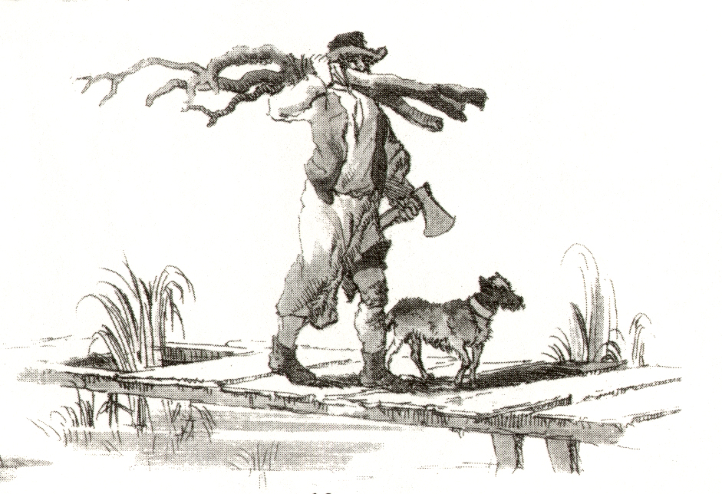
The Wood Age
A thought experiment
in past, present and future human ecologies
Max Adams

Slide 2
Invention of
the rocking chair
Hurray for B.C.
Johnny Hart
1964

Slide 3
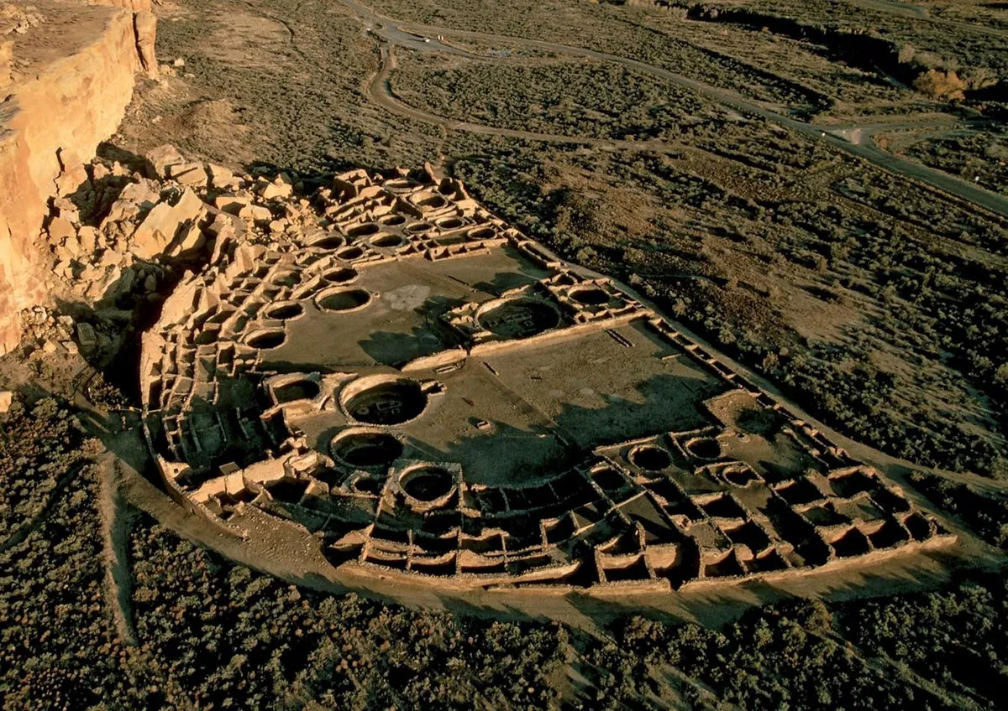
Pueblo
Bonito
Chaco Culture
National
Historical Park,
NM

Slide 4
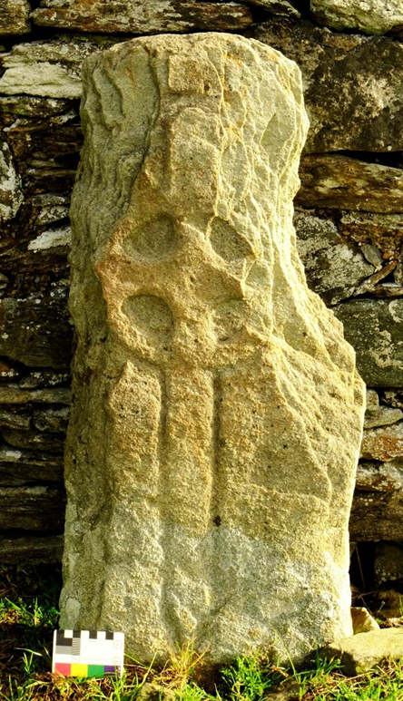
Skeuomorphic incised stone finials copied from a wooden cruck-frame chapel.
Ardwall Island,
Kirkudbright
Skeuomorphic incised cross slab.
8th century CE
Cooley graveyard,
Co. Donegal,
Ireland.

Slide 5
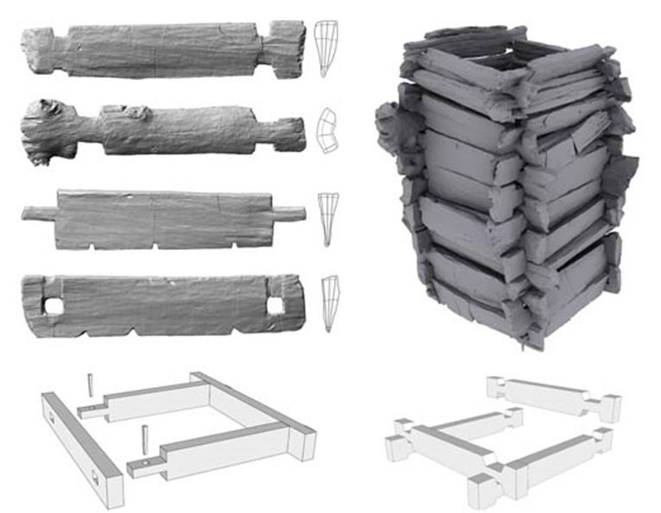
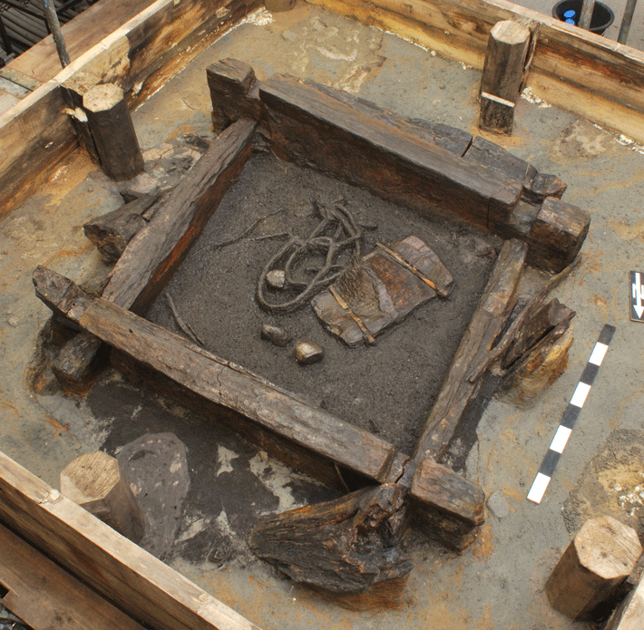
Excavation of a Neolithic
well at Altscherbitz,
Germany
5th millennium BCE

Slide 6
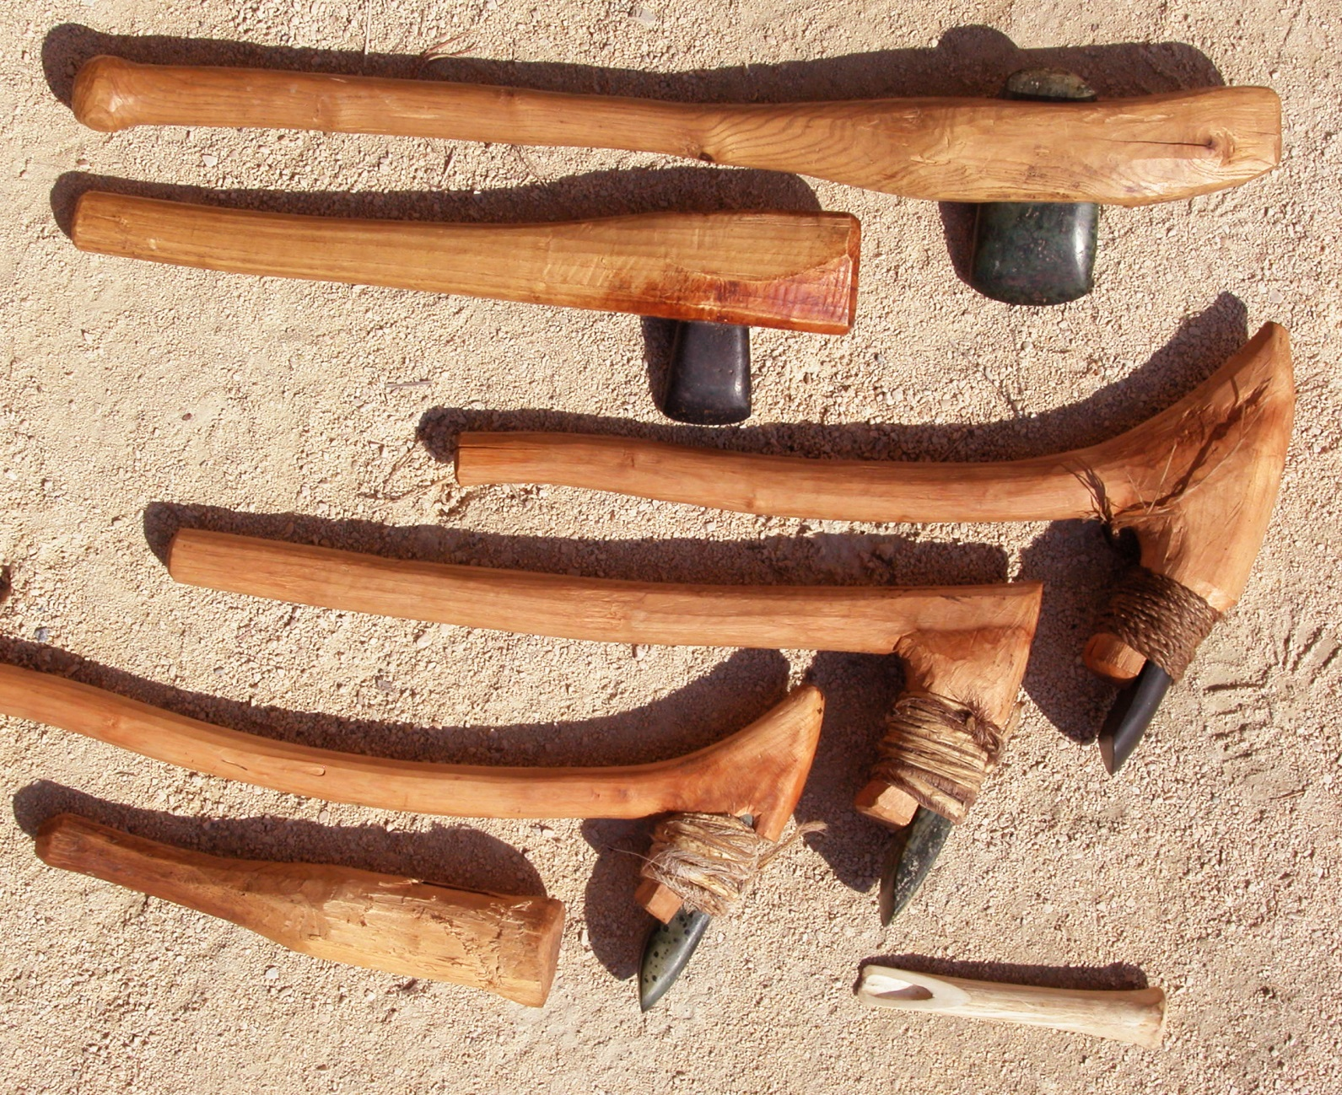
Experimental
Neolithic tool kit
Museum of
Prehistory ,
Urgeschichtemuseum

Slide 7
Wood Age
technologies
Joinery
pegs
wedges
cordage
hoops
Weapons
Furniture
Architecture
mortise & tenon
post & lintel
arch
truss
trestle
Musical instruments
Tools
axe
adze
auger
gouge
plane
saw
hammer
Traction
harness
cart
waggon
barrow
boat
Sculpture
Leverage
digging stick
paddle
cantilever
handle
pivot
Fire
hearth
oven
kiln
furnace
Presses
Containers
bowl
basket
barrel
Mills
Pulleys, gears &cams
Food
production
Dwelling
Fuel
Metallurgy
Transport
Art and arts
Artisans
cooks
potters
weavers
basketmakers
smiths
Shipwrights
canoe
raft
mast & sail
keel
rudder
Wheelwrights
axle & bearing
spokes & felloes
carrriage
shafts
Foragers
digging stick
lever
fire
Cultivators
domestication
ard & plough
hoe & rake
sickle & scythe

Slide 8
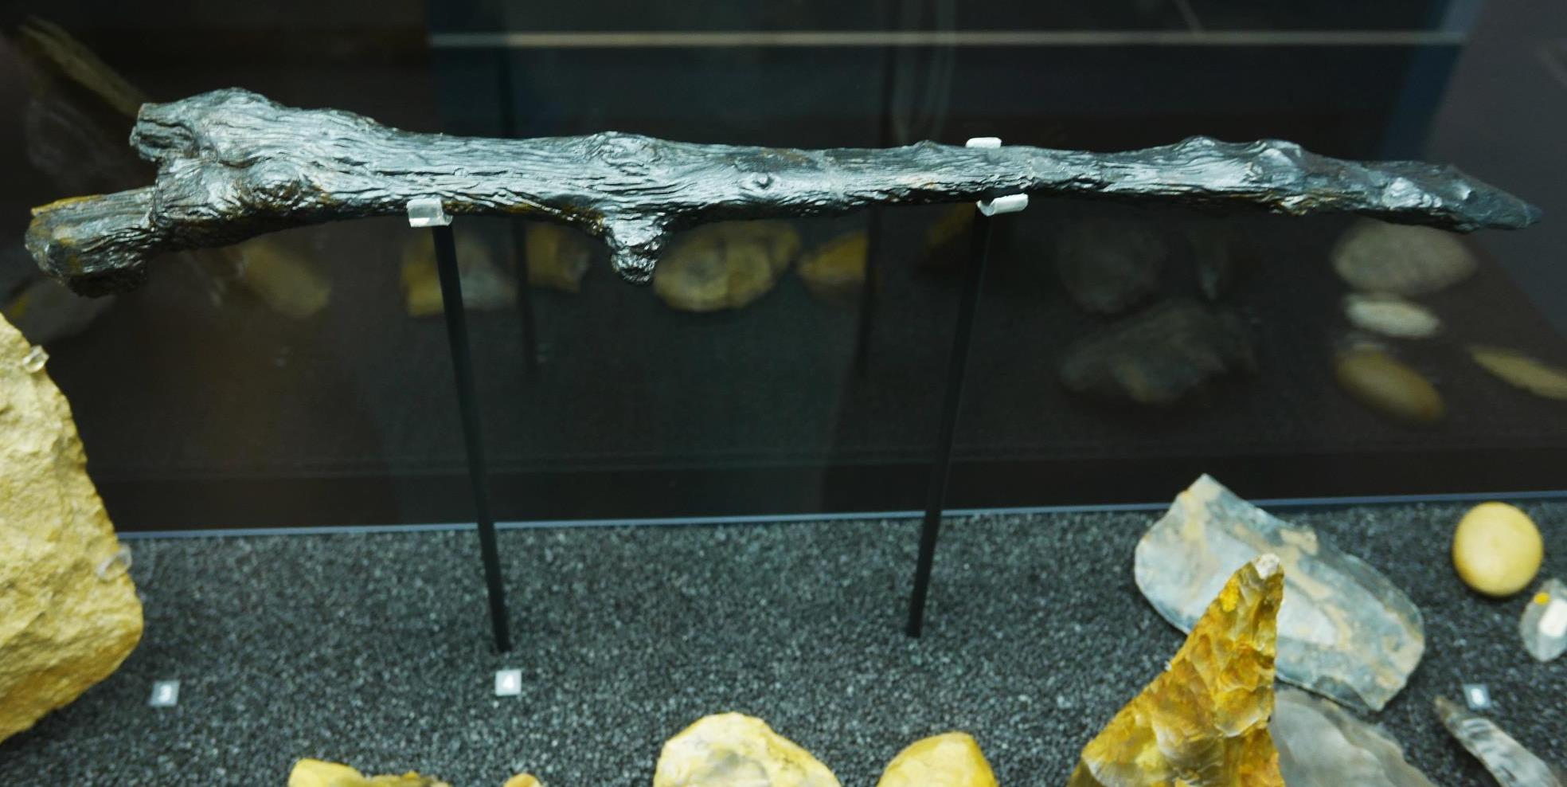
Wooden digging stick
Homo Heidelbergensis
Kalambo Falls
Tanzania
c. 300-500k BP
Natural History Museum

Slide 9
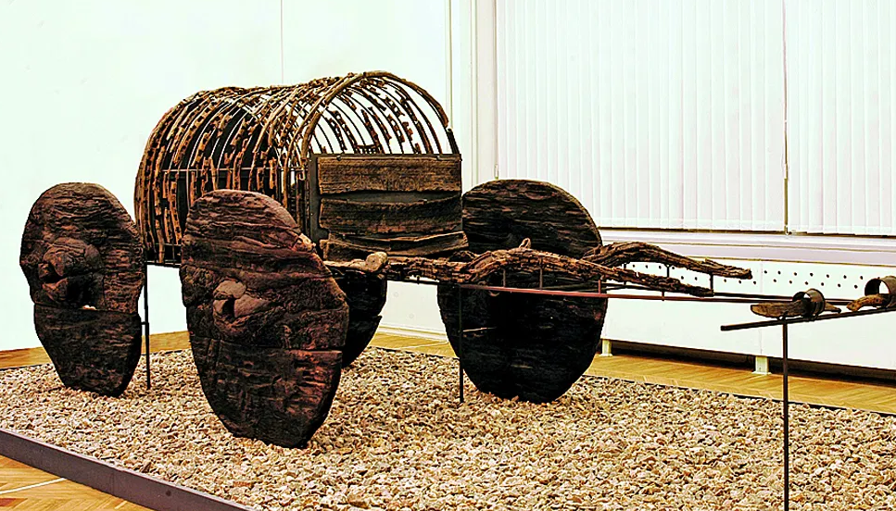
Wagon with tilt
3rd millennium BCE
Lchashen,
Armenia

Slide 10
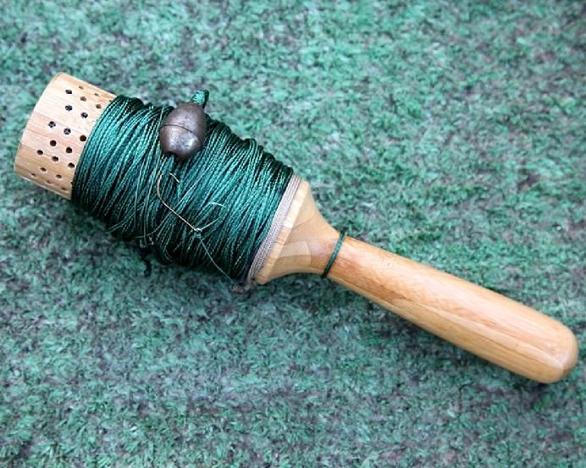
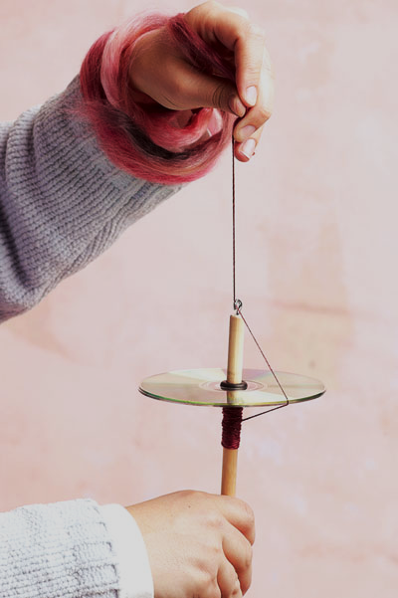
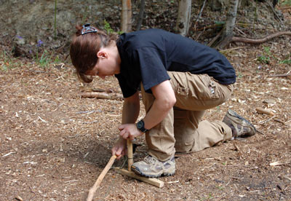
Windlass, bow drill, spindle whorl:
The emergence of the
axle/bearing/flywheel compound device..?

Slide 11
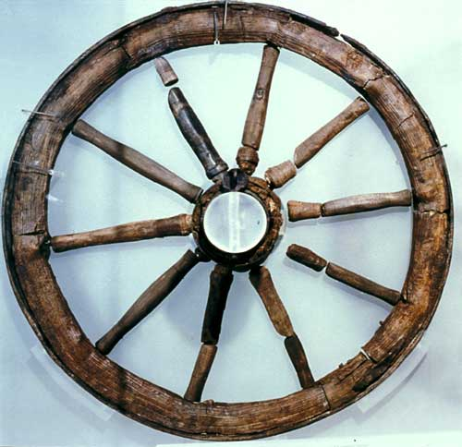
10-spoked wheel
From the Roman
fort at Newstead
1st century CE.
National
Museum of
Scotland

Slide 12
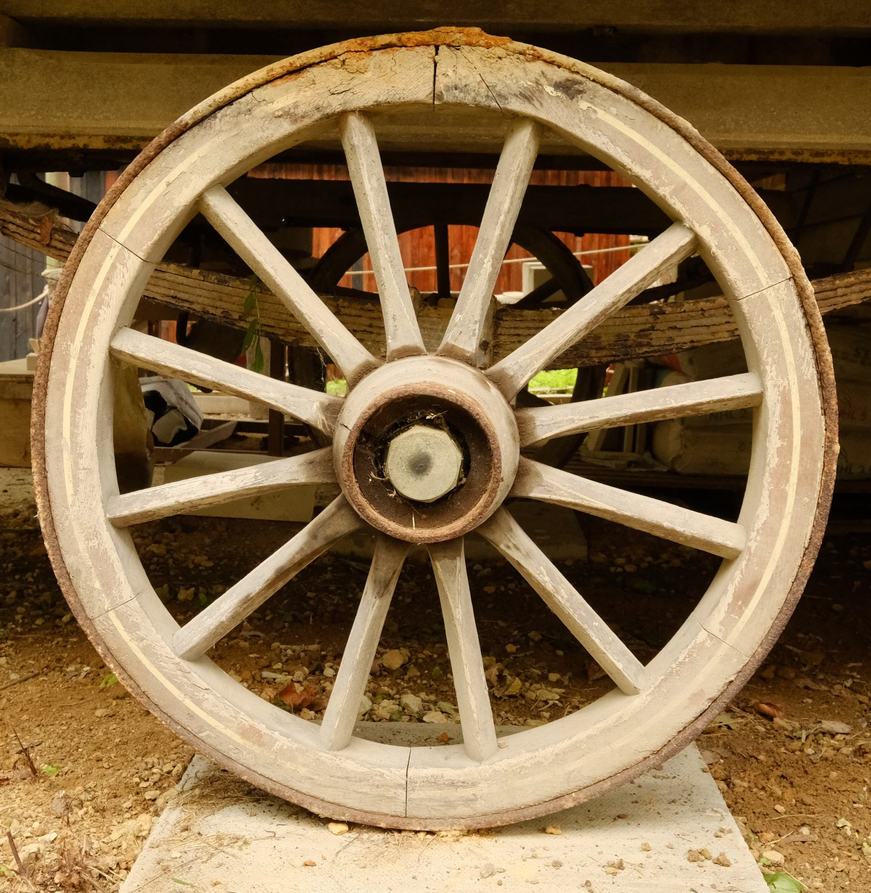
12-spoked wheel
19th century.
Weald and Downland
Museum,
Sussex

Slide 13
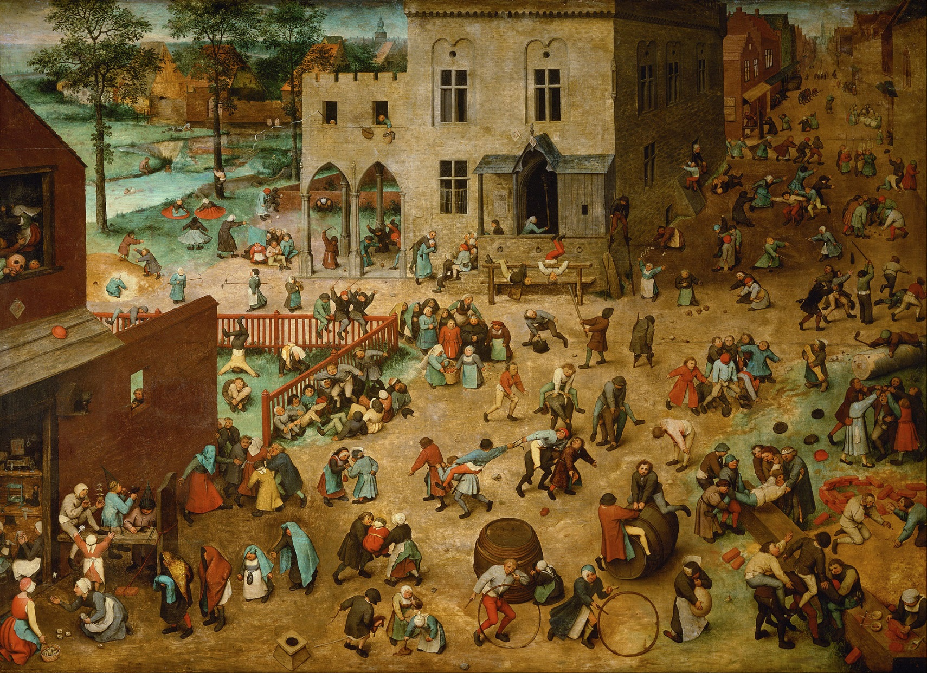
Children’s games
Pieter Bruegel
the Elder
c. 1560
Kunsthistoriches Museum, Vienna

Slide 14
Wood Age ecologies
Conservationists
reforestation
curated woodland
sustainable management
habitat restoration
climate control
Woodlanders
coppice
standards
Stewards
proprietorial rights
legal exclusion
wood tuns
wood pasture
Architects
old growth timber
underwood
trade &transport
Farmers
house
compound
paddock
field
pasture
woodland
Artisans
resource-focused
generalised experiment
specialised experiment
long distance trade
Entrepreneurs
extensive lordship
exploration & colonization
industrial processing
Foragers
seasonal migration
resource mapping
empirical knowledge
Foraging
Sedentism
Lordship
Overlordship
Conservation
roots
fruits
game
fish
herds
cultivable land
forest gardens
arable clearance
irrigation
swidden
woodpasture
pannage
firewood
charcoal production
clay
ores & native metals
coal and coke
central storage
shipping
waggons
transport networks
amenity
education
wildlife
research

Slide 15
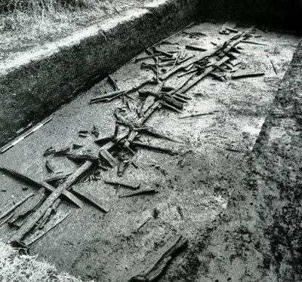
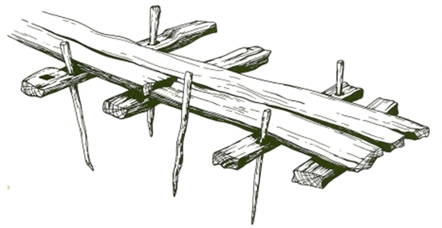
The Sweet Track,
Somerset Levels
3807 BCE

Slide 16
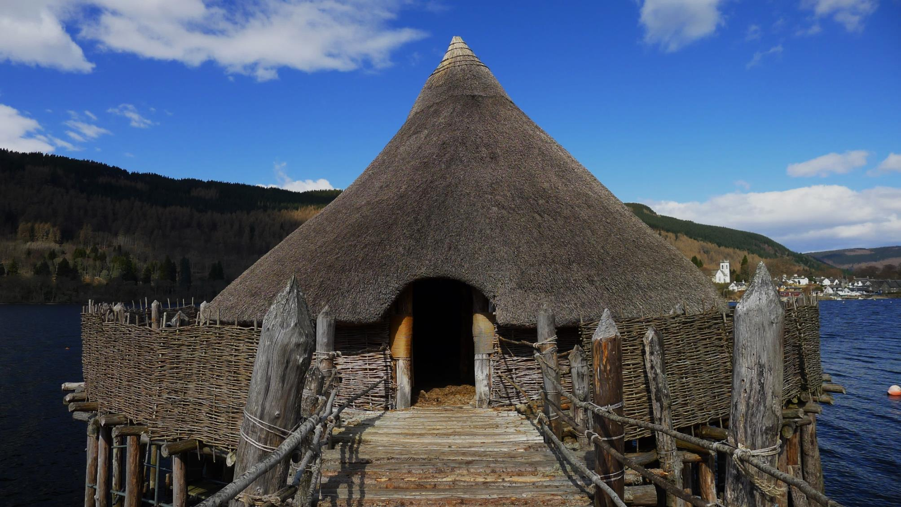
Reconstructed pile dwelling
Loch Tay Crannog centre,
Perthshire

Slide 17
Wood Age ecologies
Conservationists
reforestation
curated woodland
sustainable management
habitat restoration
climate control
Woodlanders
coppice
standards
Stewards
proprietorial rights
legal exclusion
wood tuns
wood pasture
Architects
old growth timber
underwood
trade &transport
Farmers
house
compound
paddock
field
pasture
woodland
Artisans
resource-focused
generalised experiment
specialised experiment
long distance trade
Entrepreneurs
extensive lordship
exploration & colonization
industrial processing
Foragers
seasonal migration
resource mapping
empirical knowledge
Foraging
Sedentism
Lordship
Overlordship
Conservation
roots
fruits
game
fish
herds
cultivable land
forest gardens
arable clearance
irrigation
swidden
woodpasture
pannage
firewood
charcoal production
clay
ores & native metals
coal and coke
central storage
shipping
waggons
transport networks
amenity
education
wildlife
research

Slide 18
Tritlington
Village,
Northumberland
in 1632
Wellbeck Atlas

Slide 19
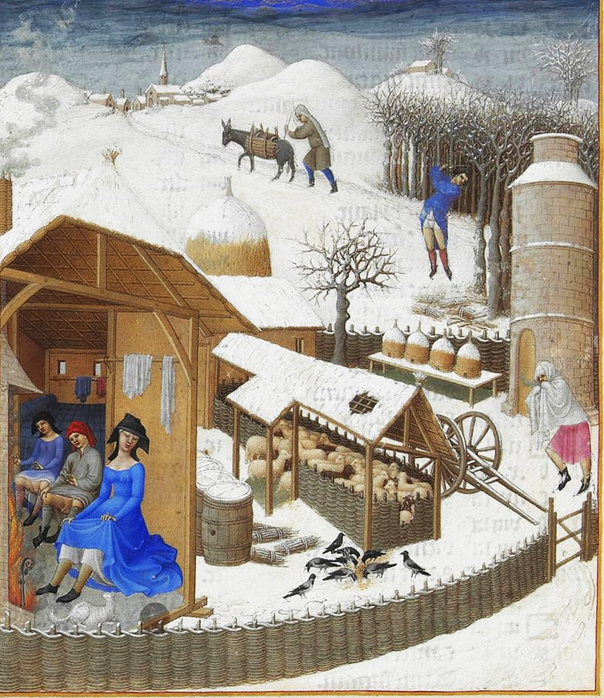
Les Très Riches Heures du Duc de Berry: Février

Slide 20
Wood Age ecologies
Conservationists
reforestation
curated woodland
sustainable management
habitat restoration
climate control
Woodlanders
coppice
standards
Stewards
proprietorial rights
legal exclusion
wood tuns
wood pasture
Architects
old growth timber
underwood
trade &transport
Farmers
house
compound
paddock
field
pasture
woodland
Artisans
resource-focused
generalised experiment
specialised experiment
long distance trade
Entrepreneurs
extensive lordship
exploration & colonization
industrial processing
Foragers
seasonal migration
resource mapping
empirical knowledge
Foraging
Sedentism
Lordship
Overlordship
Conservation
roots
fruits
game
fish
herds
cultivable land
forest gardens
arable clearance
irrigation
swidden
woodpasture
pannage
firewood
charcoal production
clay
ores & native metals
coal and coke
central storage
shipping
waggons
transport networks
amenity
education
wildlife
research

Slide 21
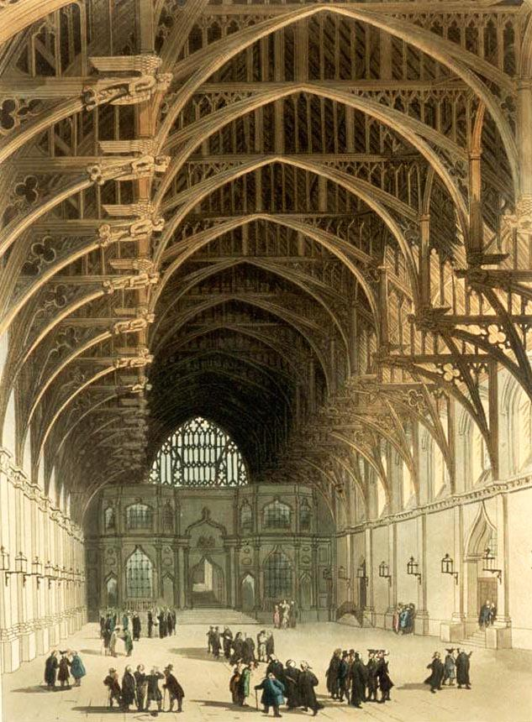
Westminster Hall,
c.1810

Slide 22
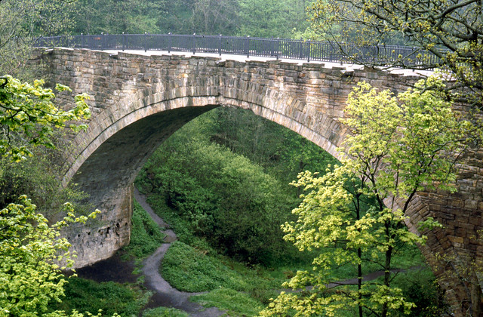
Causey Arch
rail bridge.
County Durham
1725

Slide 23
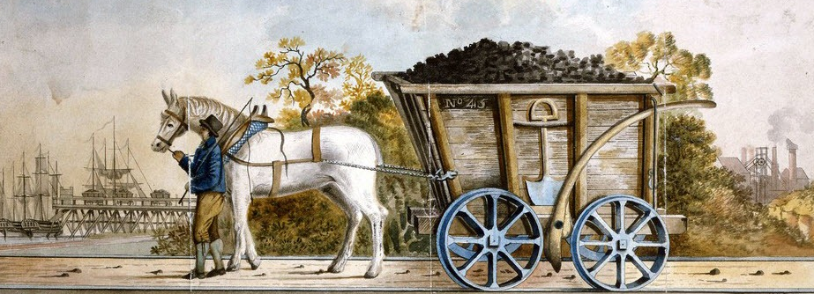
Reconstructed
Wooden coal
Waggon.
Tanfield railway,
Co. Durham

Slide 24
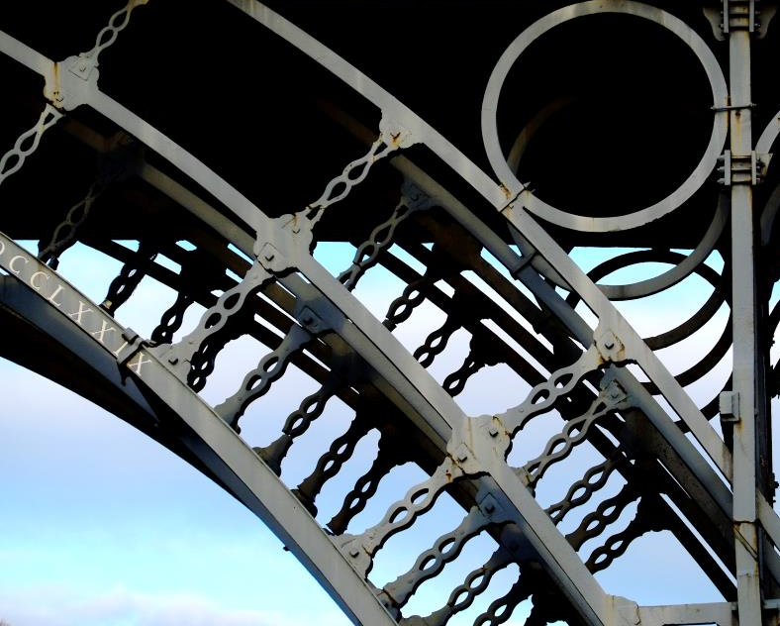
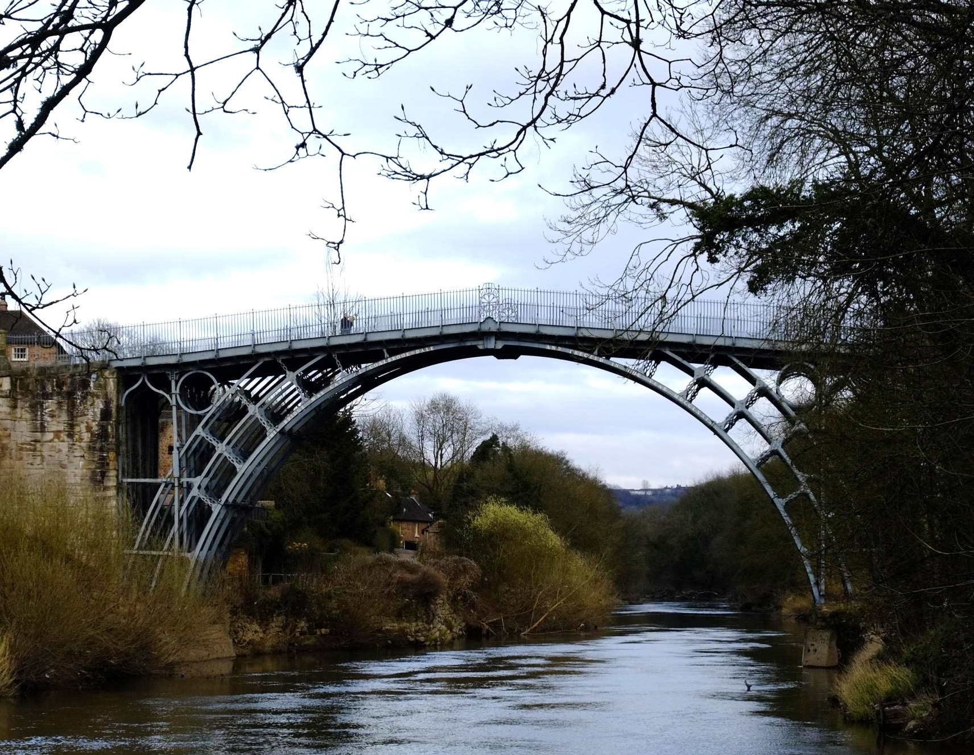
The Iron Bridge
Coalbrookdale,
Shropshire
1779

Slide 25
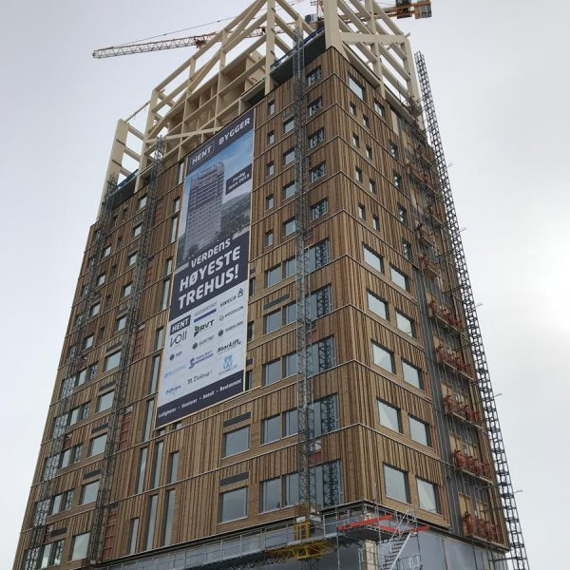
Mjøsa Tower,
Brumunddal
near Oslo
2019

Slide 26
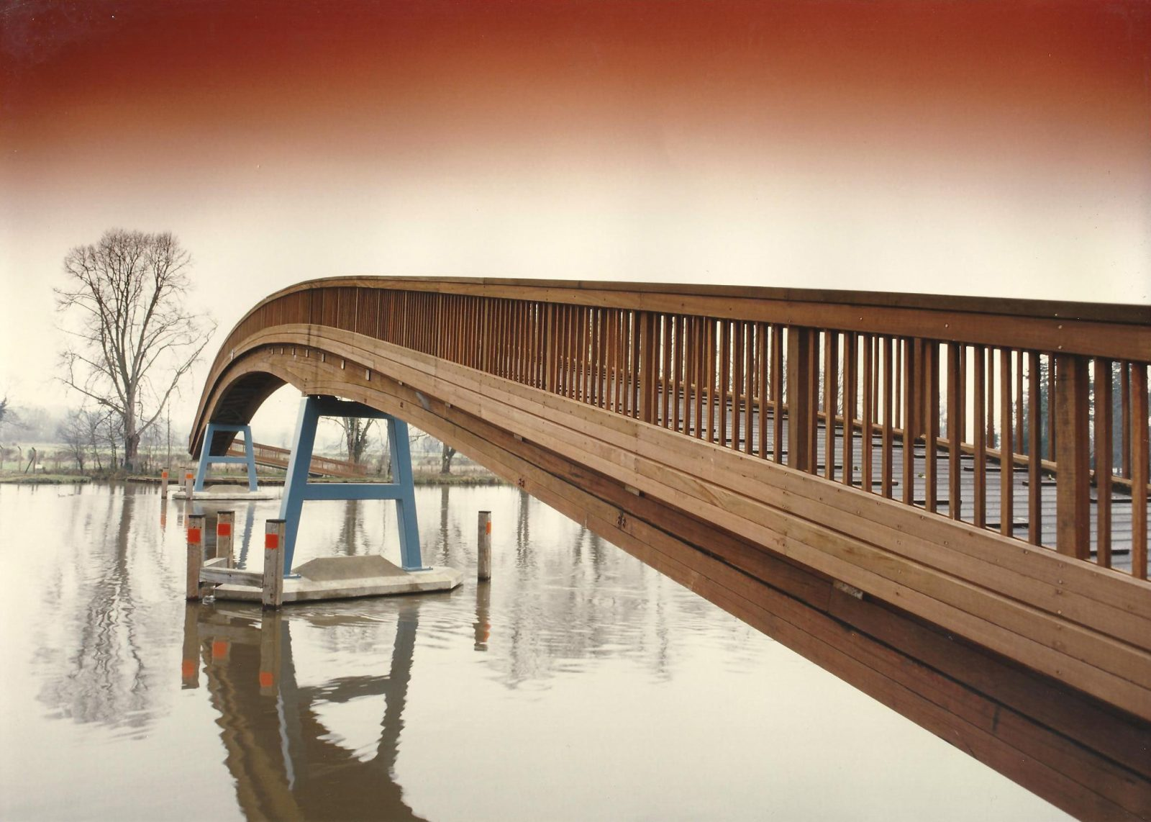

Slide 27
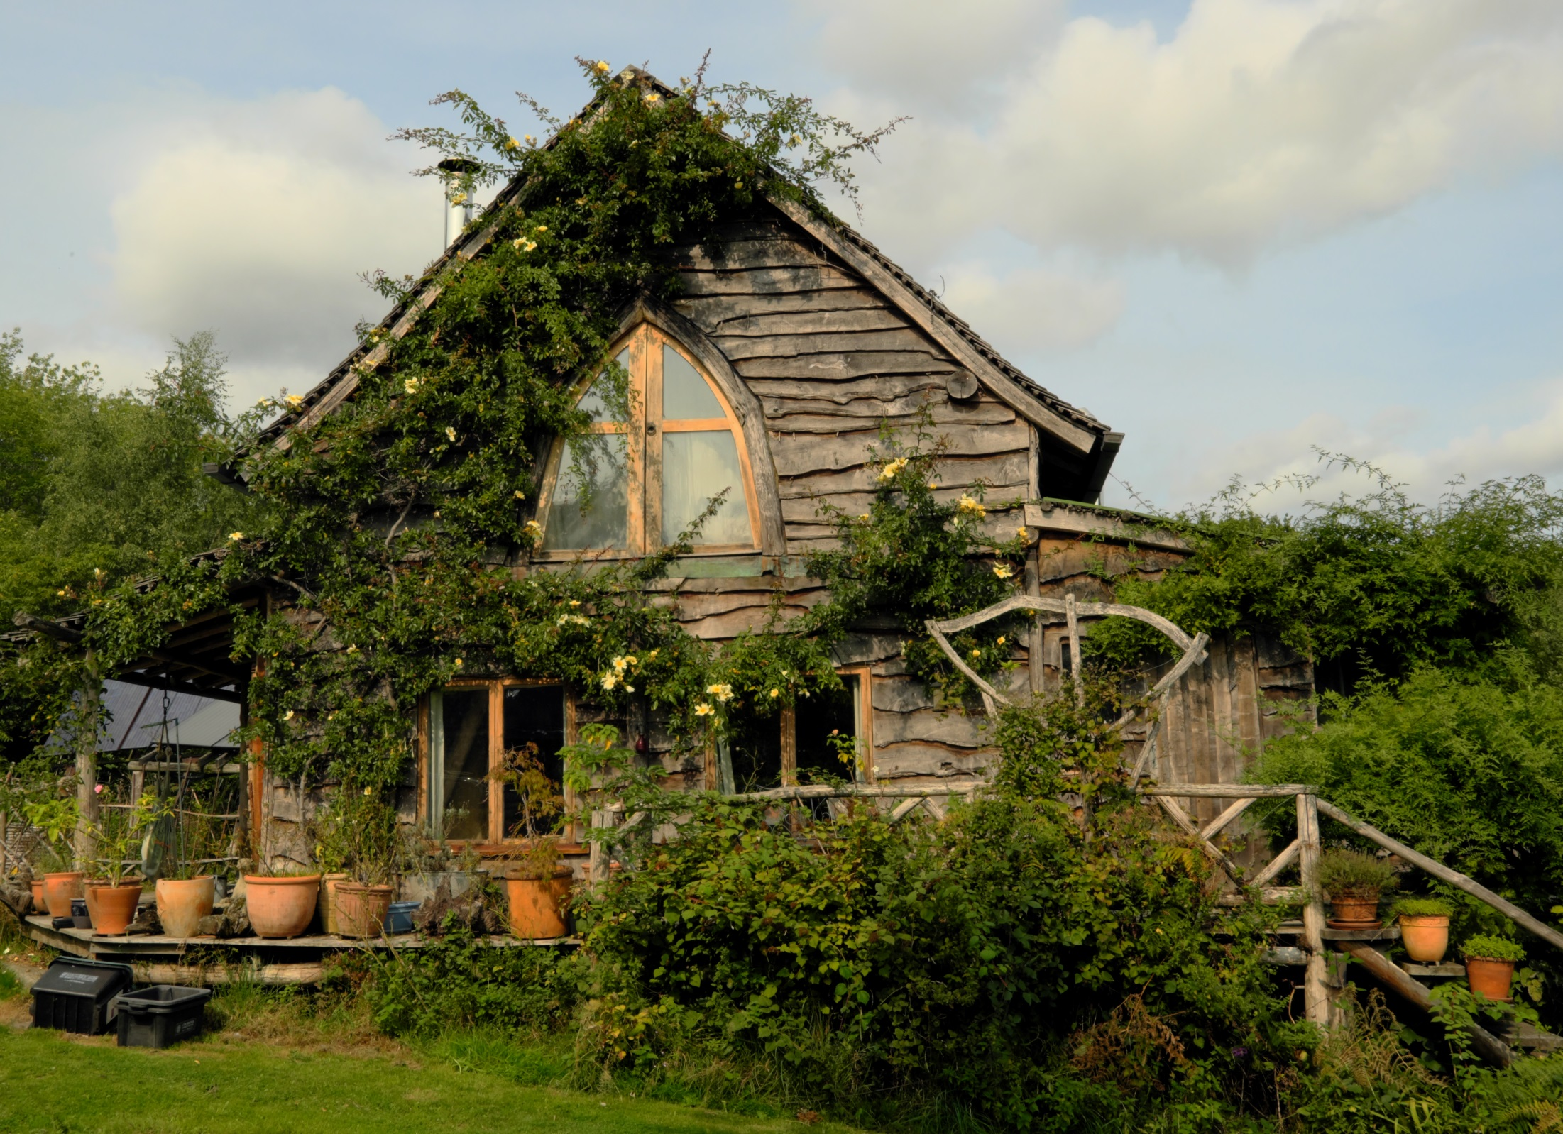
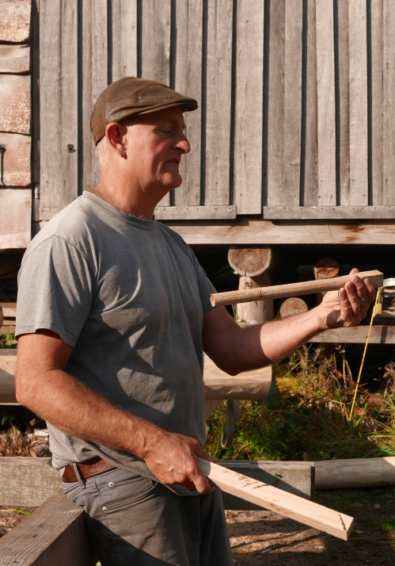
Woodland House
Ben Law 2001
Prickly Nut Wood,
Sussex

Slide 28
The Wood Age
A thought experiment
in past, present and future human ecologies
Max Adams

